Slide 1
PNEUMONIA DISEASE DETECTION USING MOBILENETV2 IN DEEP LEARNING
NAME: RAVIN RAJ S
REGISTER NUMBER: 23322009
COURSE: MASTER OF COMPUTER APPLICATIONS
INSTITUTE: THE GANDHIGRAM RURAL INSTITUTE
GUIDE: DR. M.MARY SHANTHI RANI, MCA.,M.PHIL.,P.HD
DATE: MAY 2025

Slide 2
Agenda
Introduction
Problem Statement
Objective
Dataset Description
Image Preprocessing
Model Architecture
Model Training Setup
Performance Evaluation
Mobile App Deployment
Implementation Details
System Advantages
Future Enhancements
Conclusion
References

Slide 3
Introduction
Pneumonia is an infectious disease causing inflammation in the air sacs of the lungs.
Symptoms: Cough, fever, chest pain, and breathing difficulty.
Challenge: Traditional diagnosis is manual and requires expert radiologists.
Goal of the project: Develop a deep learning-based automatic system for pneumonia detection using MobileNetV2, enabling faster and accurate diagnosis.

Slide 4
Problem Statement
Manual interpretation is:
      Time-consuming
      Subject to human error
      Limited in availability (especially in rural/low-resource settings)
Radiologists may misclassify bacterial vs viral pneumonia.
The project aims to build a mobile-compatible, AI-powered tool that supports real-time and remote diagnosis.

Slide 5
Objective of the Project
Automate pneumonia diagnosis using chest X-rays.
Classify X-rays into three categories:
  Normal
  Bacterial Pneumonia
  Viral Pneumonia
Compare two approaches:
  Without Preprocessing (raw X-rays)
  With Preprocessing (CLAHE + Median Filtering)
Deploy the best model in a mobile app for practical usage.

Slide 6
Dataset Description
Dataset Source: Kaggle - Chest X-ray Images (Pneumonia)
Total Images: 7927 grayscale chest X-rays
Three categories:
  Normal
  Bacterial Pneumonia
  Viral Pneumonia
Split:
  70% Training
  20% Validation
  10% Testing
Format: Grayscale, organized into folders by class

Slide 7
Image Preprocessing Techniques
CLAHE (Contrast Limited Adaptive Histogram Equalization)
    Enhances contrast locally in X-rays and it helps highlight important features like lung infiltrates
    Clip Limit: 0.01
Median Filtering
    Removes noise while preserving edges
    Kernel size: 1 (light smoothing)
Evaluation:
Used PSNR (Peak Signal-to-Noise Ratio) to measure image quality
Achieved average PSNR of 48.86 dB, indicating excellent image enhancement

Slide 8
Model Selection - MobileNetV2
MobileNetV2: A lightweight convolutional neural network (CNN)
Designed for mobile and embedded devices
Key Features:
  Depth-wise separable convolutions
  Low latency and memory usage
  Good accuracy-to-size ratio
Frameworks Used:
  TensorFlow
  Keras
  Google Colab for training

Slide 9
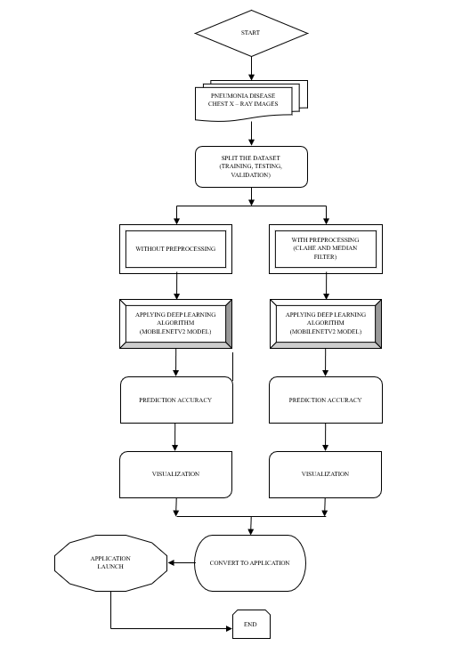
Flow Chart

Slide 10
Model Training Setup
Input Image Size: 128x128 pixels (RGB)
Batch Size: 32
Epochs: 25
Optimizer: Adam (learning rate = 0.0001)
Loss Function: Categorical Cross - entropy
Trained in two scenarios:
  Without Preprocessing
  With Preprocessing (CLAHE + Median Filter)

Slide 11
Performance Comparison
Dataset | Accuracy (without Preprocessing) | Accuracy (With Preprocessing)
Training | 94% | 99%
Validation | 84% | 86%
Testing | 83% | 84%
F1 Score improved from 83% → 84% with preprocessing
Preprocessing enhanced model’s ability to identify subtle lung patterns

Slide 12
Evaluation Metrics
Accuracy: Overall correct predictions
Precision: Correct positives over all predicted positives
Recall: Correct positives over all actual positives
F1 Score: Balance between Precision and Recall
Confusion Matrix: Visualizes misclassifications between classes

Slide 13
Evaluation Metrics
Method | Precision (%) | Recall (%) | F1-Score (%)
With Preprocess | 84% | 84% | 84%
Without Preprocess | 83% | 83% | 83%

Slide 14
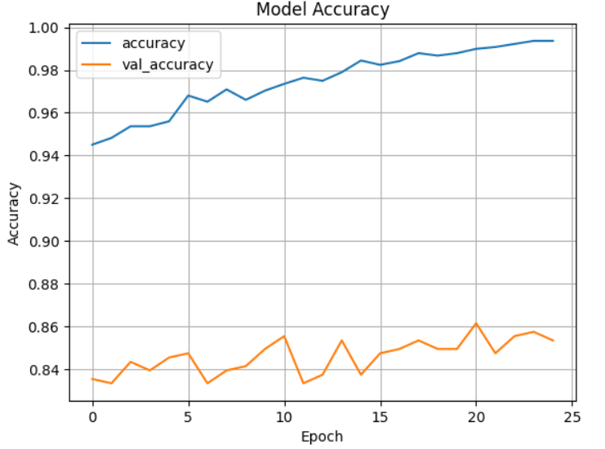
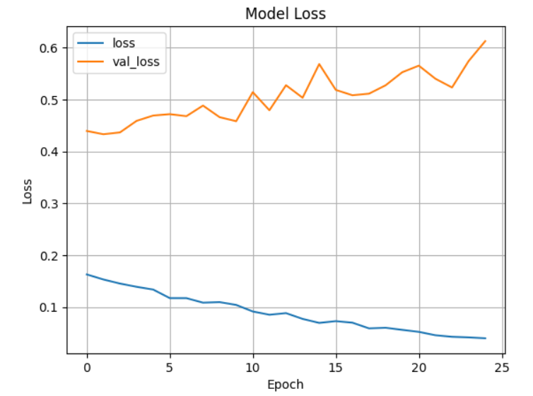
Accuracy and Loss

Slide 15
Mobile App Deployment
Model converted using TensorFlow Lite (.tflite) format
Android App developed using Android Studio
Key Features:
    Upload X-ray
    View real-time prediction (Normal/Bacterial/Viral)
    Lightweight and offline-capable
Simple UI for use by healthcare workers

Slide 16
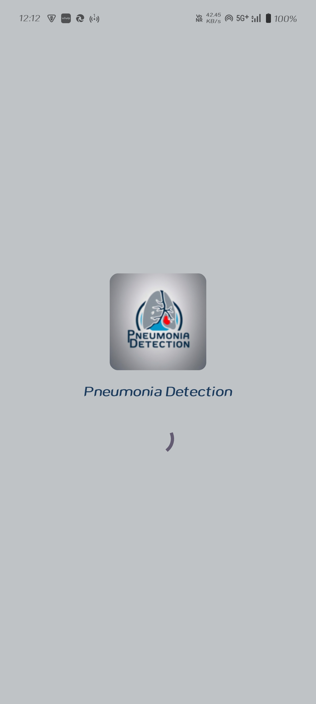
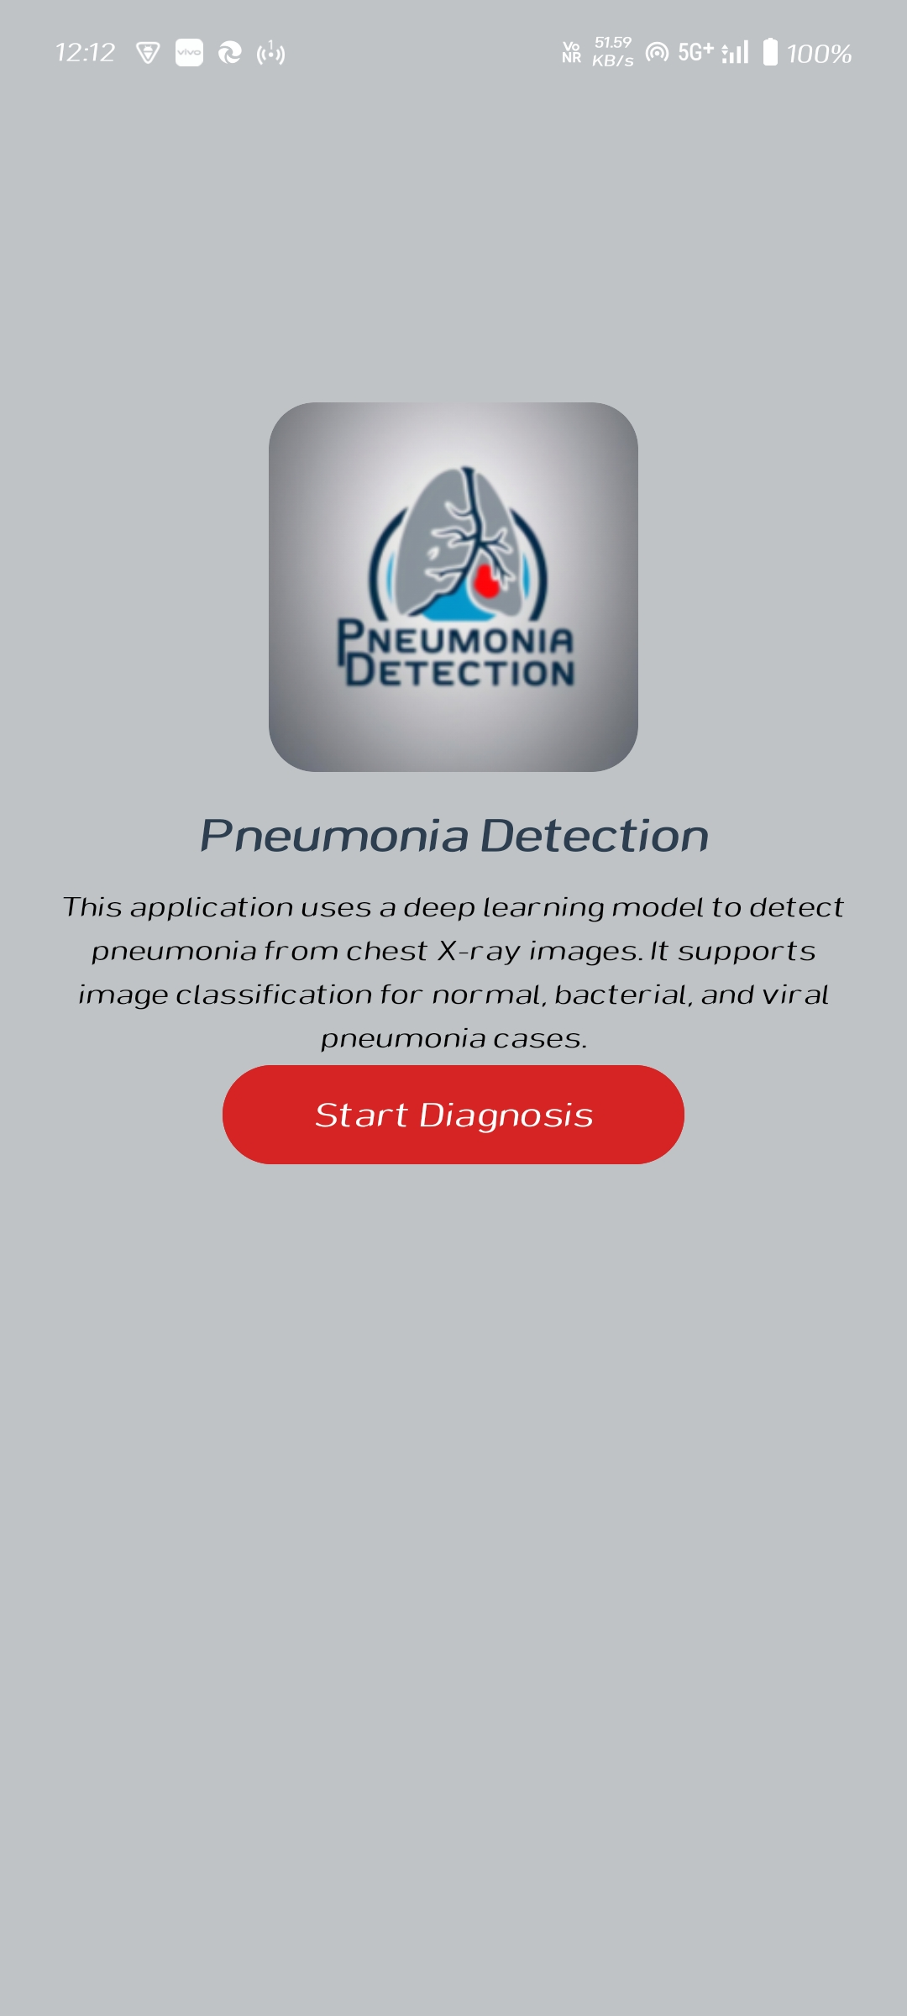
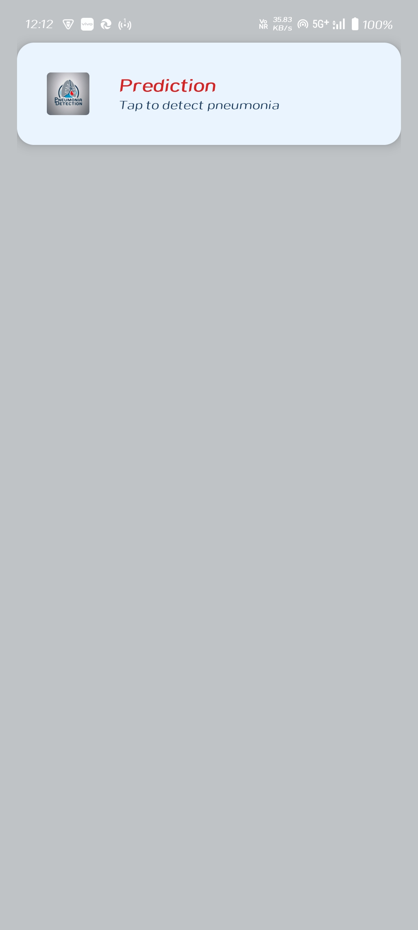
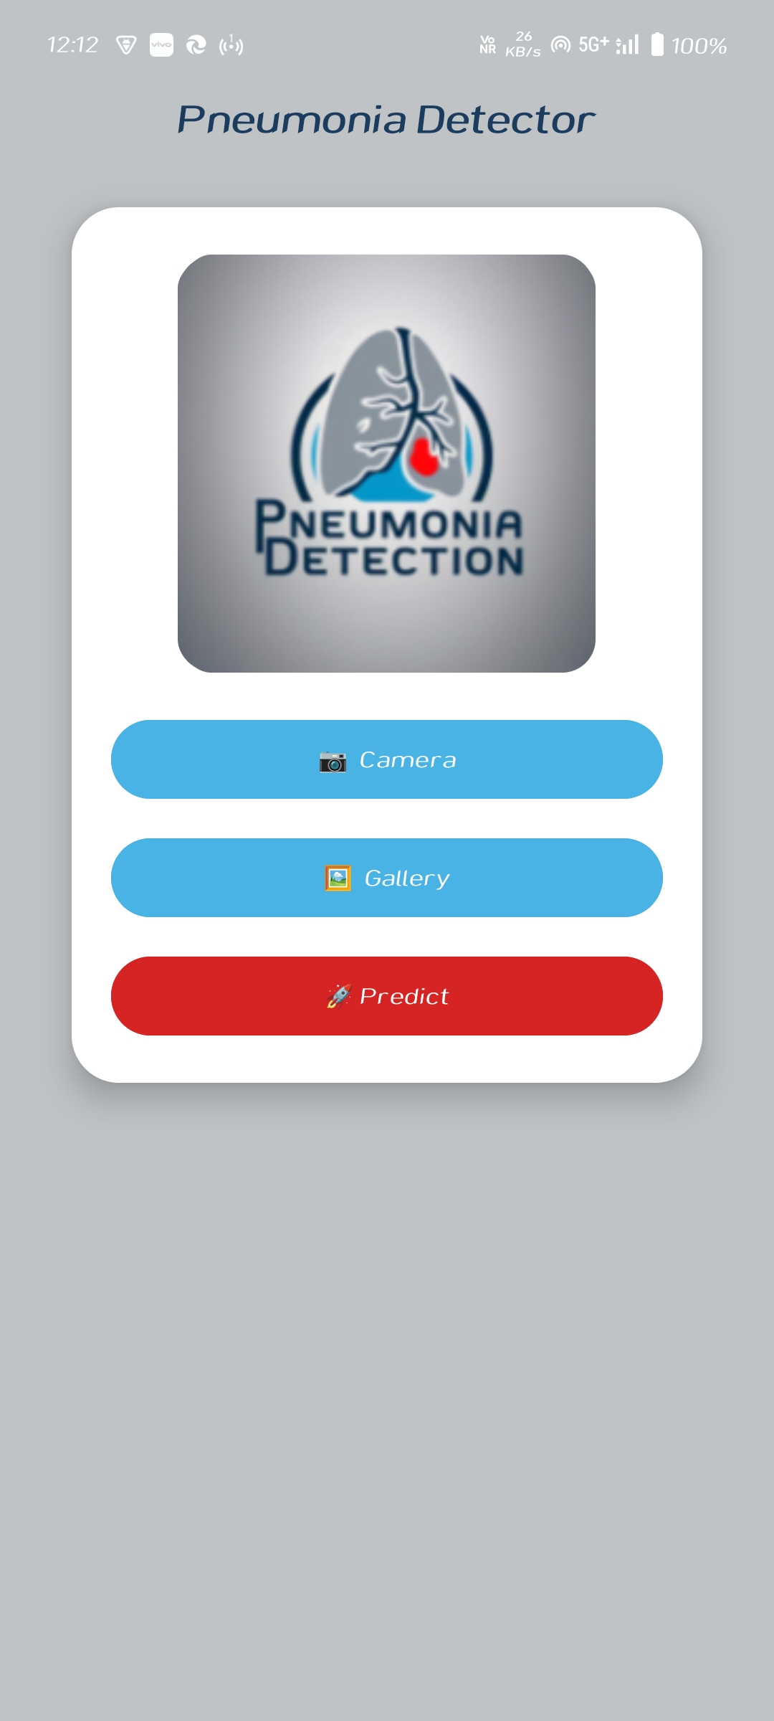
Applications Screenshots

Slide 17
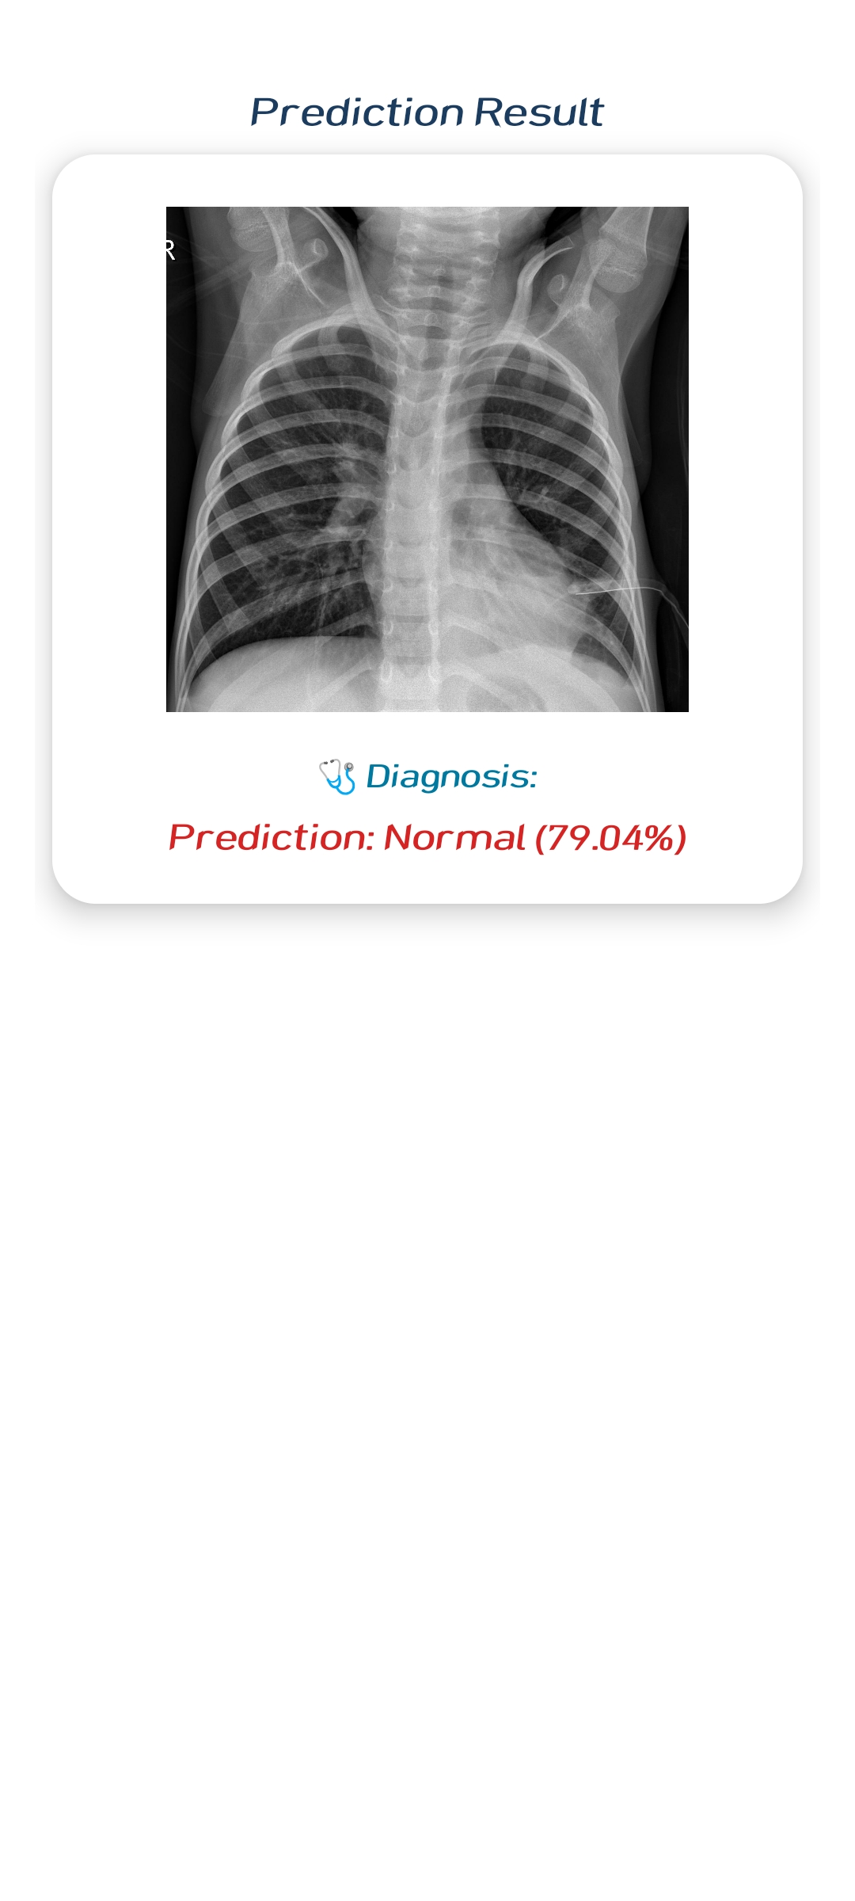
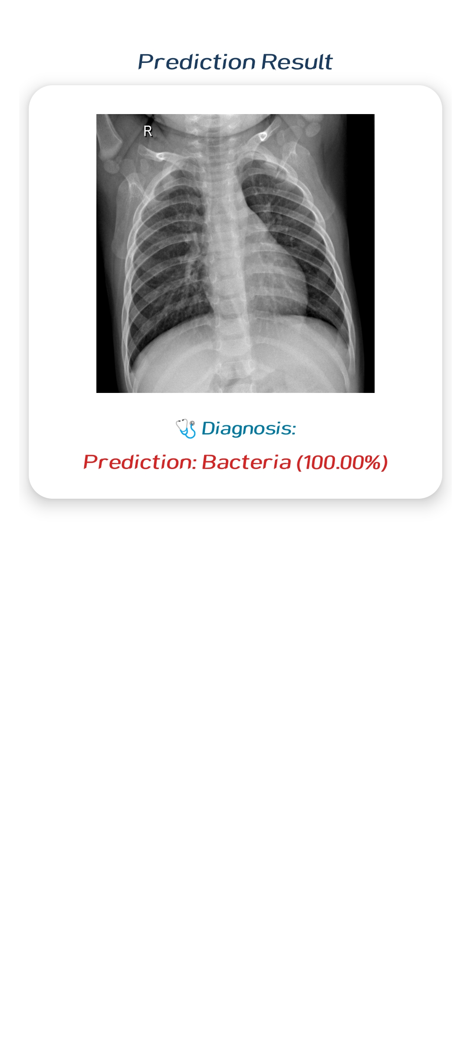
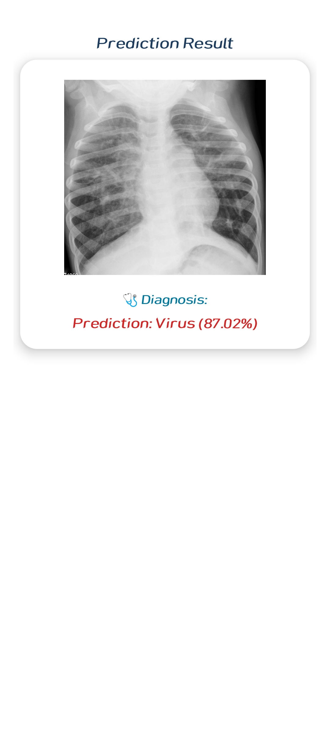
Applications Screenshots

Slide 18
Implementation Details
Preprocessing in Python (OpenCV, NumPy)
Model Training in Google Colab
App Backend: Java (for TensorFlow Lite integration)
Frontend UI: XML
App tested on multiple Android devices for compatibility and performance

Slide 19
Advantages of the System
Accurate classification using MobileNetV2
Preprocessing improves diagnostic clarity
Can be used in low-resource regions
Helps reduce burden on radiologists
Portable, scalable, and real-time detection

Slide 20
Future Enhancements
Extend model to detect:
  Tuberculosis
  COVID-19
  Lung cancer
Integrate Grad-CAM for visual explainability
Add confidence scores to predictions
Enable live camera capture
Cloud integration (Firebase/AWS)
Voice & regional language support
EHR (Electronic Health Record) functionality

Slide 21
Conclusion
This project demonstrates how deep learning and mobile technology can assist in early detection of pneumonia.
CLAHE and Median filtering improve image clarity and model accuracy.
MobileNetV2 achieves excellent results and enables mobile deployment.
The system bridges AI innovation with real-world medical diagnostics.

Slide 22
References
Books:
    “Deep Learning” – Ian Goodfellow et al.
    “Deep Learning for Medical Image Analysis” – Zhou et al.
Web Resources:
    Kaggle: Chest X-ray Dataset
    TensorFlow Lite Documentation
    OpenCV: CLAHE
    Scikit-Image: Median Filtering

Slide 23
Thank you

